Slide 1

Manatee Population Trends
Taylor Woodington
Notes:
Hello everyone, today we are going to be taking a dive into manatee population trends within the state of Florida. This state is known for its abundant wildlife which includes many species but one often sticks out. That would be the manatees.

Slide 2
The Problem
Human Wildlife Conflict
Boat Strikes
Population Status
Notes:
Manatees will go to the coasts of the shore and get caught in a conflict that we need to pay attention to. Due to the manatees coming close to the Florida shores and beach, we have a human wildlife conflict of competing habitants in a way. Many people use these areas for recreation with their boats which unfortunately leads to boat strikes of these manatees which could be a life threatening risk for the animal and a risk for those driving the boat as well. Overall, this could be declining the manatee population that many facilities fight to keep healthy through rehabilitation and reintroduction programs.
It is important to understand the population and amount of manatees visiting the area to have proper precautions in place.

Slide 3
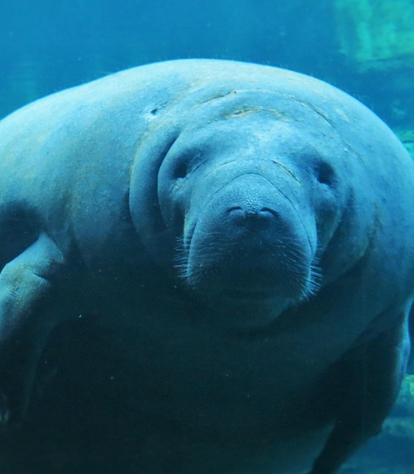
Background Florida Fish and Wildlife Conservation Commission
Location
County and State
Time of Year
By Months
Population
Adult Count
Calf Count
Notes:
In order to get this better understanding we are going to look into some data that comes from the Florida Fish and Wildlife Conservation Commission which includes important information such as observation location by county and state (which will be Florida), time of year by months, and population with an adult and calf count at each observation time.

Slide 4
Preparation and Methods
Converting date to date time format
Drop missing values
Descriptive Statistics
Averages of count by month
Averages of adult and calf counts throughout the years
Notes:
In order to prepare for an analysis of this data I decided to convert the date to a date time format easier for analysis and separating observations, drop missing values to decrease

Slide 5
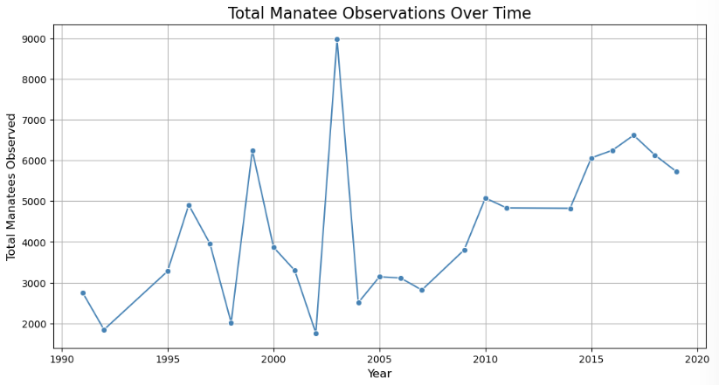
We see a steadier increase after 2005
Notes:
When we first start to observe the data we will see there is a lot of spikes in the observation count of manatees over the year but it becomes more consistent and steady after 2005. This could be due to warmer weather, more individuals observing, and more.

Slide 6
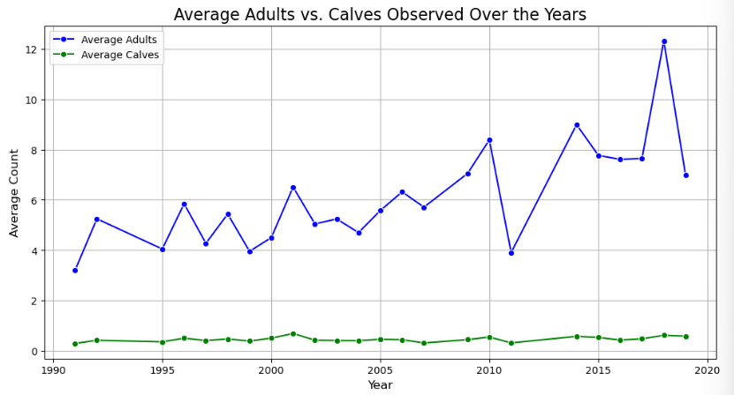
High Average Adult Count over the Years
Low Average Calf Count over the Years
Notes:
To look a little more into the specifics we can see that the adult count is significantly higher than the calf count. After running a correlation analysis we see a correlation value of 0.86 which is a positive correlation showing that as adult count increases, calf count increases.

Slide 7
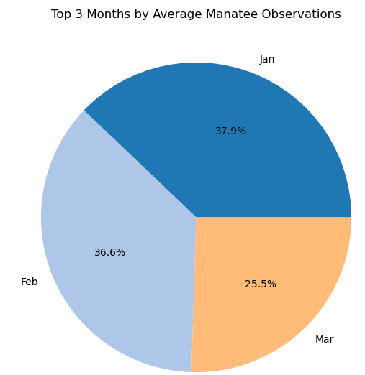
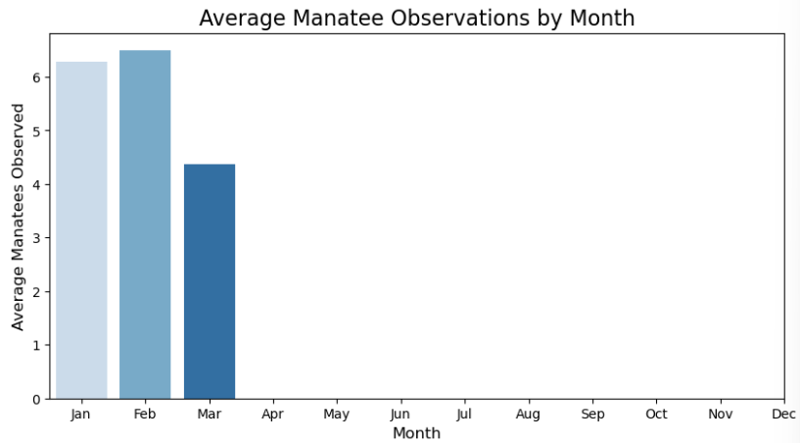
Observations only made from January throughout March
Notes:
Within each year I took a closer look to see which months were the most valuable for observation, here we can see that only the Months January, February, and March have observations, this could be due to the colder weather being those months in Florida which means the weather closest to the coast will be better for the Manatees survival.

Slide 8
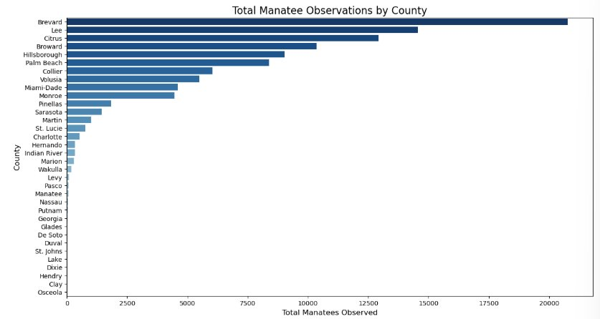
Some Counties on the East Coast Most on the West
Notes:
For further analysis, I looked further into which counties saw the most manatees. Here we can see Brevard, Lee, and Citrus as the counties with the highest number of observations. While some of the counties are on the east coast, many of them are on the west. This could be because the west coast is the coast which is within the gulf which has warmer water than the east with more water cycling through from the ocean. With more area of water on the east, the harder it is to keep it at an optimal temperature for the manatees.

Slide 9
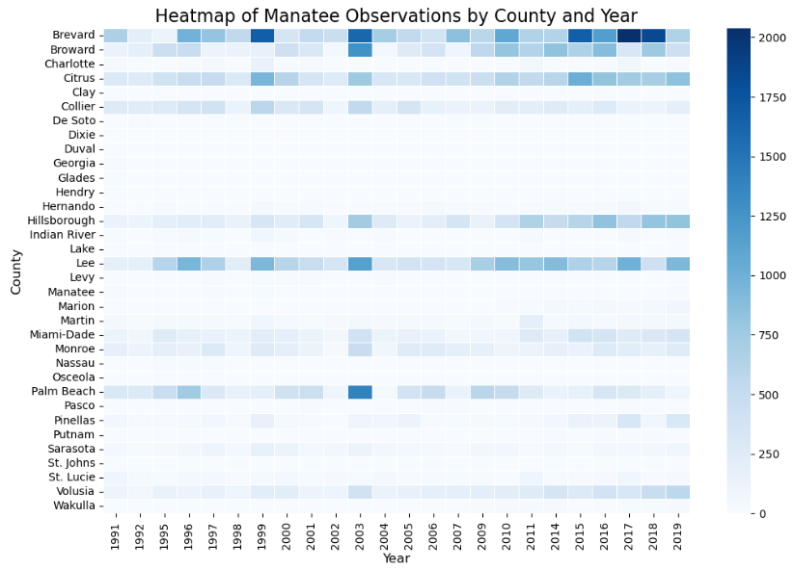
Notes:
Now that we have analyzed the month, years, and location I wanted to see the correlation over the years for the different counties. It seems to be consistent that the counties discussed and shown in the previous bar graph have had the higher count of manatees over the year.

Slide 10
Conclusion and Assumptions
Observations include more adult manatees than calves
Higher count in the colder months of the year
Counties with the high number of manatees in observation are on the West Coast
Manatees are high in number during certain times and in certain places due to them looking for warmer waters
Notes:
With this consistency and all the other data collected we can see that most observations include more adults in the count than calves, the numbers are higher during cold months, and most of the counties with the high count are on the West coast. All of this leads me to assume that the manatees are high in number during these times and certain locations because they are looking for warmer waters to be in during the winter to increase their chance of survival.

Slide 11
Future Recommendations and Implementation
Collect weather and water temperature data
Run relationship models on manatee count, weather, and water temperature
Manage counties to increase safety for manatees and limit risks for all
Notes:
While I have assumed this, it may not be true. In the future I would recommend more data be collected on the weather of those counties during those years and months of observation to see if higher numbers correlate to higher water temperature. This would mean cross referencing the correct degree of weather for the day in those counties and the water temperature during those observations with this data set to run models that show correlation. Following that, counties can manage more of the ecotourism and boating areas to include areas that are safe for manatees to spend their time and be protected from possible boating risks.

Slide 12
References
Habitat. Florida Fish And Wildlife Conservation Commission. (n.d.). https://myfwc.com/wildlifehabitats/wildlife/manatee/habitat/
Manatee Synoptic Survey Observation Locations. Florida Fish and Wildlife Conservation Commission. (n.d.). https://geodata.myfwc.com/datasets/manatee-synoptic-survey-observation-locations/explore?location=27.834871%2C-82.273454%2C6.44&showTable=true

